Slide 1


AASHTO Innovation Initiative PS&E C-Rev Overview
Herndon, Virginia
Suriyanarayan Sadasivam
Deputy Project Manager, AASHTO Innovation Initiative
December 12, 2018

Slide 2

The objectives of the webinar today are to be able to:
Objectives
Learn about the AII program
Learn about a new PS&E collaborative review process that you can share with your stakeholders

Slide 3
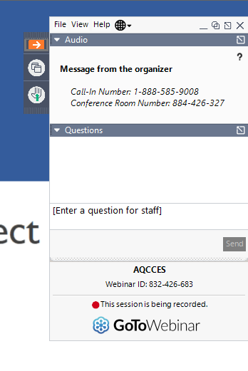
GoToWebinar Orientation
The Control Panel has
A small orange arrow used to expand or hide the control panel
A question box where you can enter questions

Slide 4

Please participate…
Housekeeping Items
Respond to polls that appear on your screen
Post questions in the QUESTION BOX at any time during the webinar – we’ll answer them during the moderated Q & A

Slide 5
Attendee Polls
Attendee Polls

Slide 6
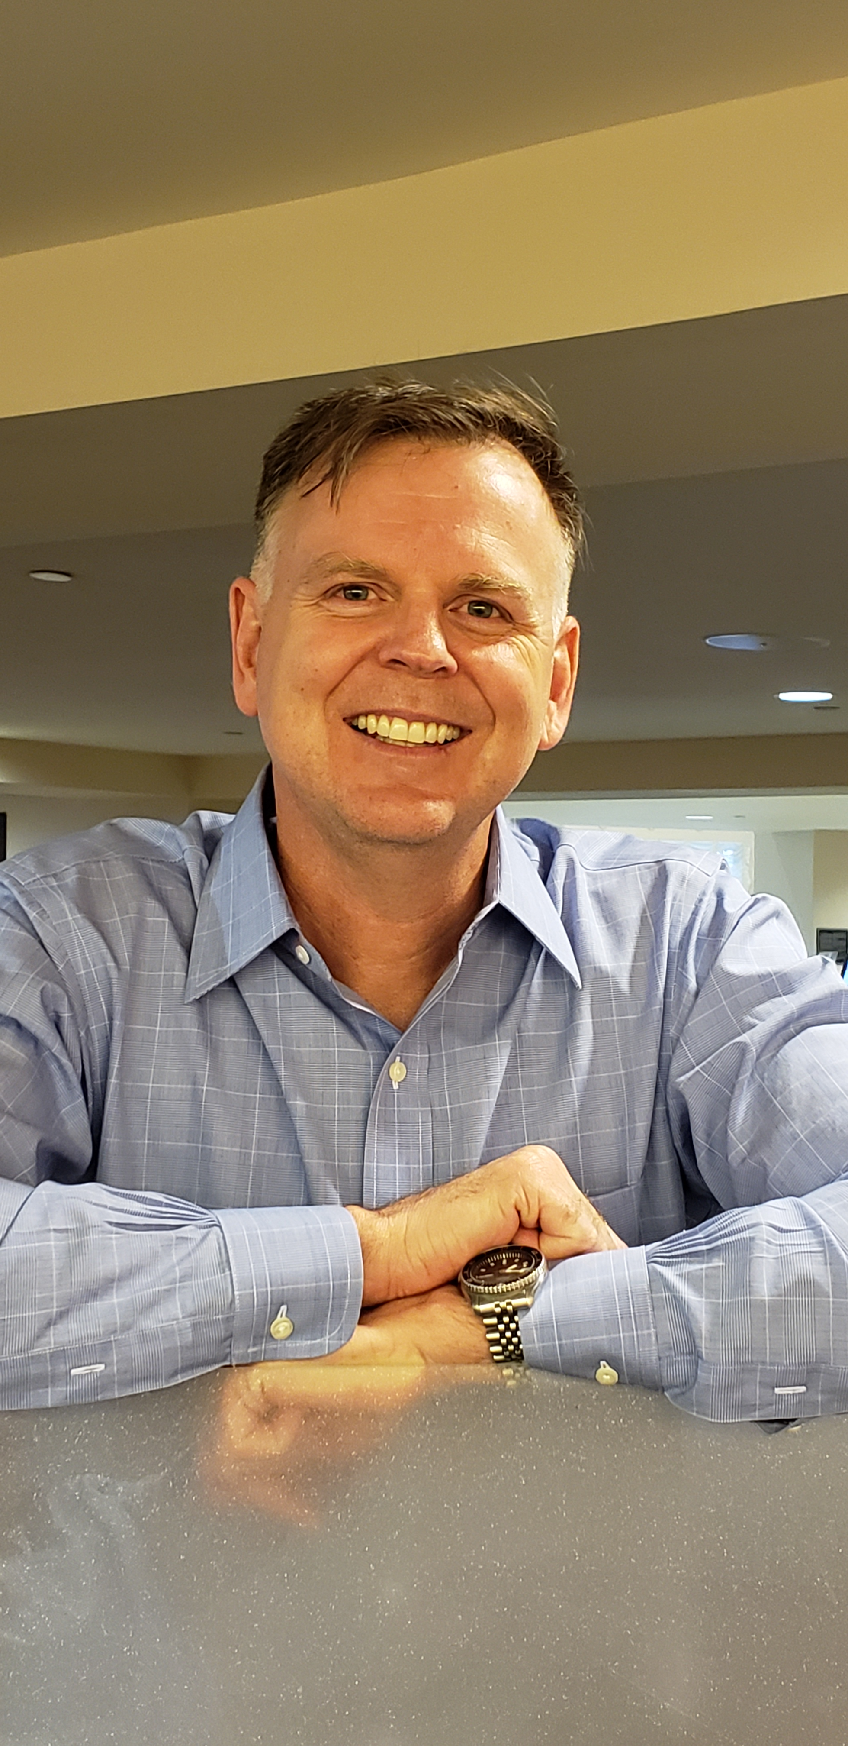
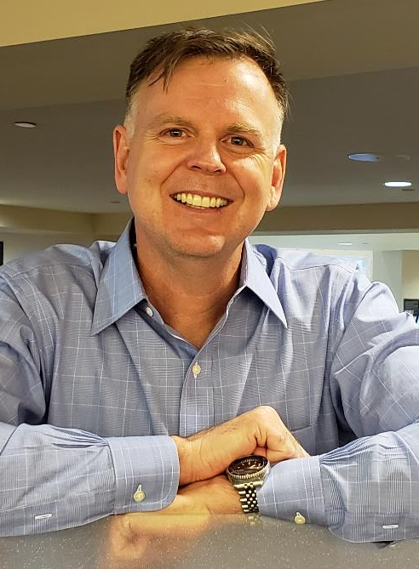
Introductions
Glenn Page

Slide 7
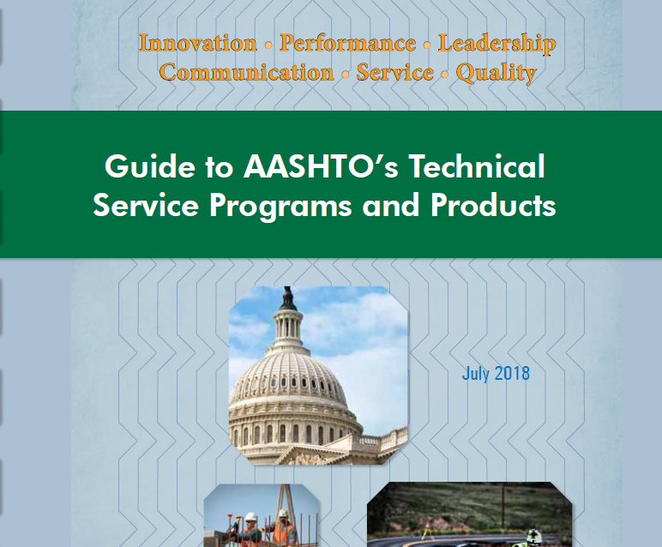
AASHTO Innovation Initiative (A.I.I.)
AASHTO Re:source
AASHTOWare
National Transportation Product Evaluation Program (NTPEP)
Development AASHTO Materials Specifications (DAMS)
Notes:
AASHTO Innovation Initiative (AII)
AII 1 of about 20 Technical Service Program Most common are
AASHTO Re:source, AASHTOWare, NTPEP, DAMS (Development of AASHTO Materials Specifications)

Slide 8
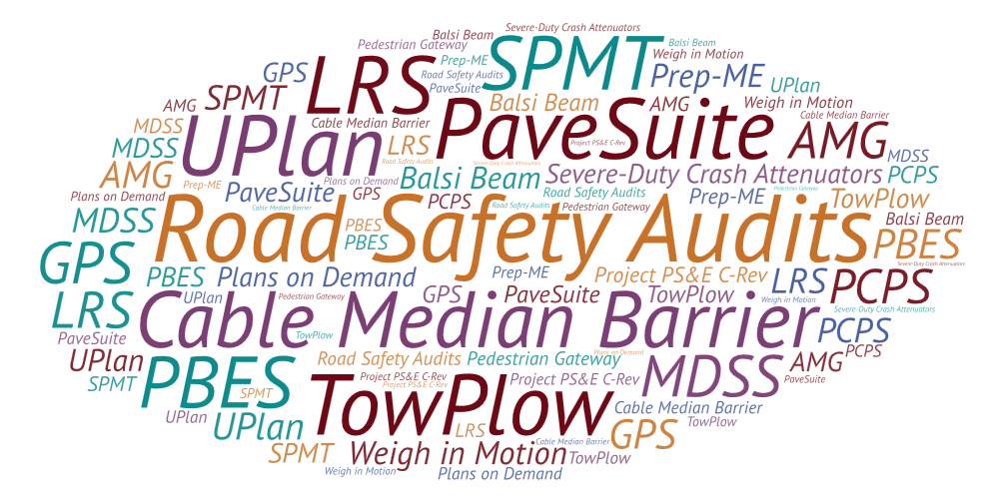
All About AII
Formally established in 1999 & Operating since 2000
Formerly called Technology Implementation Group
Facilitate the implementation of high-payoff, ready-to-use, innovative technologies
  Focus Technologies
  Additionally Selected Technologies
Support the implementation of 100+ technologies since 2001

Slide 9



AII’s Role in the Technology Lifecycle
Research
Lead States Pursue Practical Applications
AII
Industry Practice

Slide 10
Recent Active Focus Technologies
Project PS&E C-Rev
Pedestrian Gateway Treatment
Wrong Way Driver (WWD) Detection Systems
Interactive Visualization

Slide 11
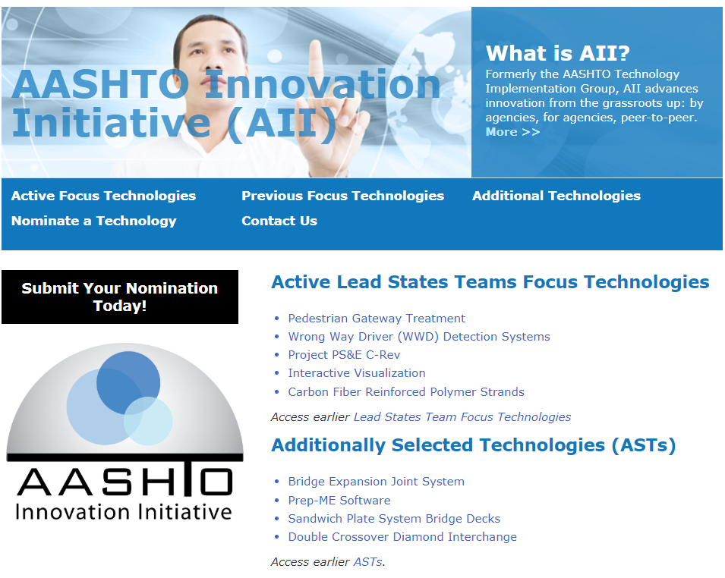
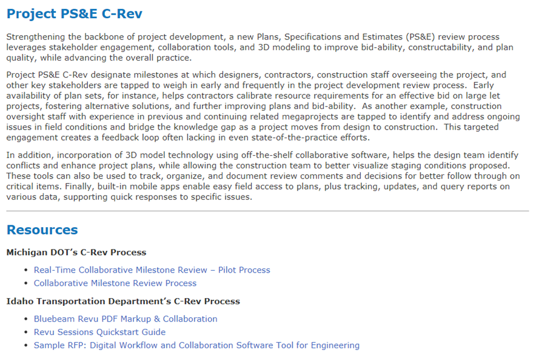
http://aii.transportation.org
Notes:
This slides includes animation.
Refer to the AII website. The website includes additional information on the AII program as well as webpages for each focus or additionally selected technology.
If a user clicks the link for Project PS&E C-Rev [press ENTER key to enable animation], it takes to a page that provides a description of the innovation as well as additional reference documents shared by our lead states team.

Slide 12
Attendee Polls
Attendee Polls

Slide 13
PS&E C-Rev: Cloud Based Plan Review
Milwaukee, Wisconsin
Ryan P. Luck, P.E.
Wisconsin Department of Transportation – Construction Chief
December 12, 2018

Slide 14

Ryan P. Luck, PE
Presenter Background
Wisconsin Department of Transportation
  Southeast Freeways Construction Chief
  28 Years Experience
  Program Manager
  Oversee Construction of Freeway Mega/Major Projects

Slide 15
Historical Background
Marquette Interchange
Zoo Interchange
$810 M
Pockets of Institutional Experience
Silos of Information
$1. 71 B
PS&E C-Rev
Scalable
Industry Buy-in
Trust Component
2004
2012
Technology Movement
2000
2010
2020
I-94NS / Mitchell Interchange
$1.91 B
Cultural Change
Size / PS&E Process
Resources / Time Management

Slide 16
PS&E C-Rev: Cloud Based Plan Review
Purpose & Need
Over the past decade, WisDOT SE Region has successfully completed two Mega projects, which included several LETs with overlapping and adjacent construction packages being let. With the latest Mega-Project: Zoo Interchange program began, it was evident through review of lessons learned, that better hands on coordination between design, construction, and contractors was critical to future successful project delivery.
  Factors:
  Anticipated size of plans (5000⁺ sheets)
  Highly complex staging, sequencing, and construction activities envisioned,
  Large Project Management Teams: Designer & Construction Personnel
WisDOT believed it would be difficult to capture all the value added comments and meaningful changes that the current PS&E review process would accommodate. A process with better coordination had the potential to create better quality projects, while avoiding costly change orders, and ensuring consistency between sequenced lets within the program.

Slide 17
Traditional Delivery Process
Design – Bid – Build Process
Cursory plan review (30%/60%/90% Milestone Reviews)
  WisDOT Ad Hocs
  WisDOT Project Team
2D printed plans (11x17)
Limited Industry Outreach/Feedback
Challenges of traditional process
  Integration of all functional design areas
  Separate design and construction teams
  Minimal changes after 90% review
30% REVIEW

Slide 18
PS&E C-Rev
Fundamental Theory & Concepts
Success
=
People
+
Process
+
Tools
In order to innovate change you have to be able to disrupt the current structure and identify the areas for improvement. Areas that can directly affect change are:
Your People – resources, capacity, grit, knowledge, open to feedback, teamwork
Your Process – continual improvement, open to efficiency, inclusive
Your Tools – adapting to meet project needs, effective use of the most efficient tool to maximize ROI, schedule demands, mobility, volume, visibility, priority

Slide 19
PS&E C-Rev
Mission Statement
Incorporate a collaborative Plans, Specifications & Estimate (PS&E) review process to improve:
    bid-ability
    constructability
    overall plan quality
By way of:
    expanded participation of industry and construction experts in the review
    cloud based technology enhancing efficiency
    3D model integration

Slide 20
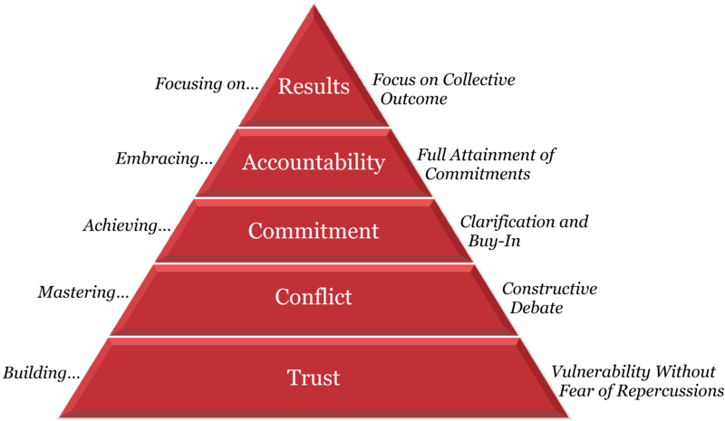
PS&E C-Rev
People
Cost
Schedule
Quality
A Culture Check
Does your team exhibit these Five Behaviors?
^{Full transparency}
^{Being open to receive critique}
^{Debate of design perspectives}
^{Agreement on moving forward}
Follow-through: inclusion into plans
Design Team
Construction Team
“Five behaviors of cohesive teams-pyramid” by Patrick Lencioni

Slide 21
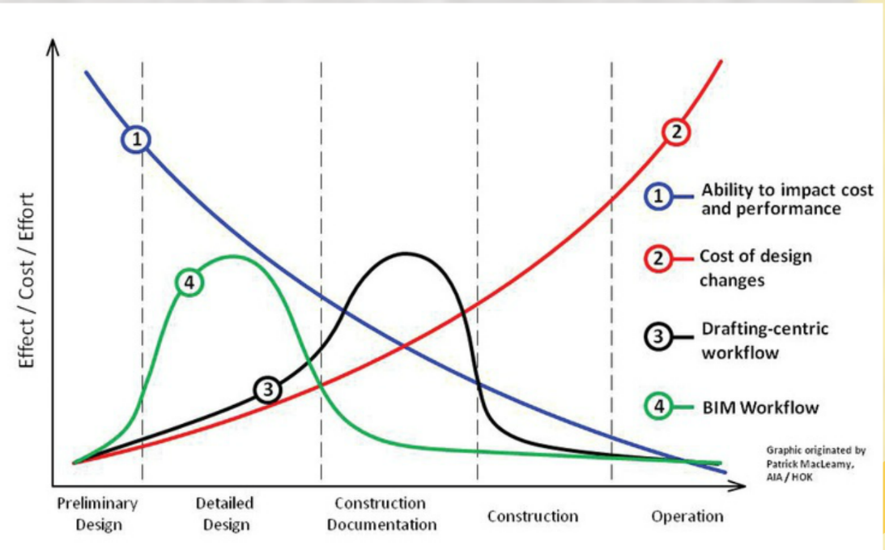

PS&E C-Rev
Process
Maximizing Change while
Minimizing Rework
MacLeamy Curve using PS&E C-Rev
$$$
GOAL: Early and often decision-making
^{CHALLENGES:}
As time progresses with design the ability to effect change becomes more difficult, becomes more costly, requires additional effort
Strategizing a timetable to maximize your resources effort correlating to the design phase to achieve the greatest impact
Team buy-in to receive full transparency: ALL PARTIES
Ability to impact cost
and performance
Effect / Cost / Effort
Cost of design
changes
Drafting-centric
workflow
Enhanced PSE
PS&E C-Rev Workflow
/ BIM360
$ _{savings}
review
Base graphic originated by Patrick MacLeamy.
AIA/HOK
Preliminary Design
Detailed
Design
Construction
Documentation
Construction
Operation
Time

Slide 22







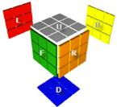



PS&E C-Rev
Tools
Out with the old,
in with the cloud…
^{Realizing Project Demands:}
  ^{Physical Restrictions:}
  5,000+ plan sheets = $465.00 per full set printed
  ^{Volume / Weight}
  ^{Cultural Challenges:}
  Team buy-in to receive full transparency: ALL PARTIES
  Varying degree of technological expertise
  Printed plan set…”How I’ve always done it”
24/7
ePlans

Slide 23
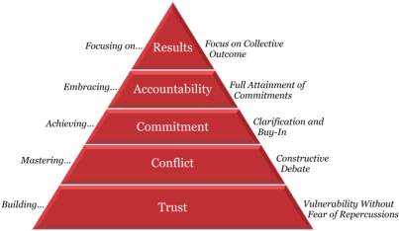
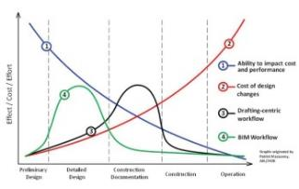
PS&E C-Rev
Road Map
Step 2
Step 3
COMMUNICATE
RESOLVE
Conflict
Commitment
Accountability
Step 1
Step 4
Cost
Schedule
Quality
IDENTIFY
INCORPORATE
Trust
Results
z
IMPROVED
  bid-ability
  constructability
  overall plan quality

Slide 24
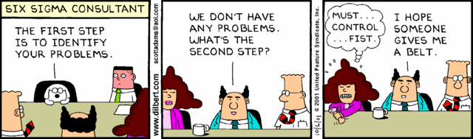
PS&E C-Rev
Step 1: “Identify”

Slide 25
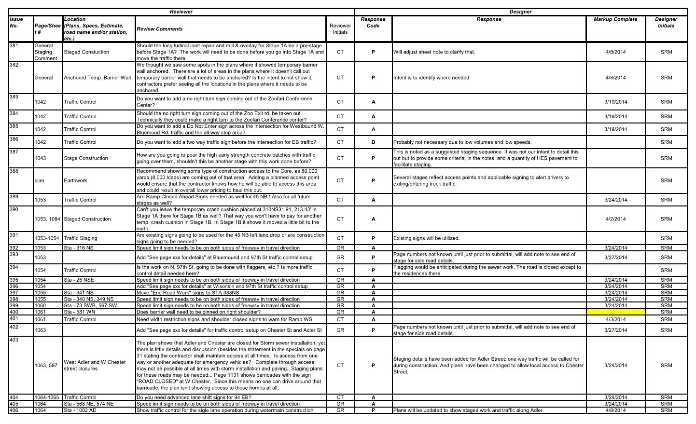
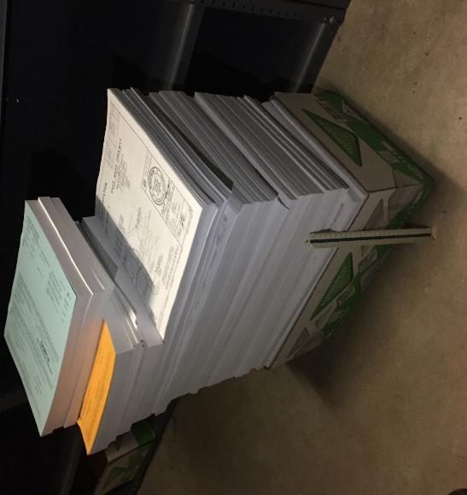
Step 1: Identify
Traditional Process
  Spreadsheet Method
    Zoo I/C Core 1: 22 Spreadsheets / 1,200+ Comments
42”
Zoo Phase I & II
Plans & Specs
Notes:
Zoo Core 1 vs Zoo Core II
Spreadsheet issues
Plan review leader

Slide 26
Step 1: Identify
Communication Goals
GOAL =
EARLY IDENTIFICATION
New & Enhanced Lines of Communication
External Parties – Construction Contractors
  Early feedback on project bid-ability
  Identifies risk areas: phasing, staging, weather, material resourcing, etc.
  3D Model & AMG surface release for estimating / resource productivity
  Better understanding of project complexity
  Contractors get a head start on operational logistics, material procurement and potential teaming options
Internal – DOT & Consultant Construction Experts
  Design | Construction C-Rev at 60%; 90% Design (best practice ROI)
  Communication: ……solve the rubix cube…..
    “No more spreadsheets” - file versioning, formatting errors, aggregation of comments
    Becoming effective communicators – less back-n-forth for clarification

Slide 27







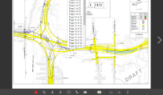
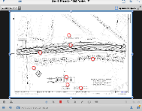
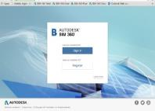





Step 1: Identify
“The Tool"
Design Team
2D Plans & 3D BIM
Construction Management & Mobility
Preloaded
Plan Set
Real-time Feedback
Website Accessibility
Comment Validation / Simple Workflow
BIM 360 Field
Construction Team

Slide 28
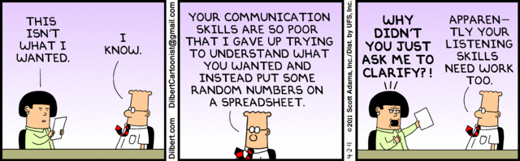
PS&E C-Rev
Step 2: Communicate

Slide 29
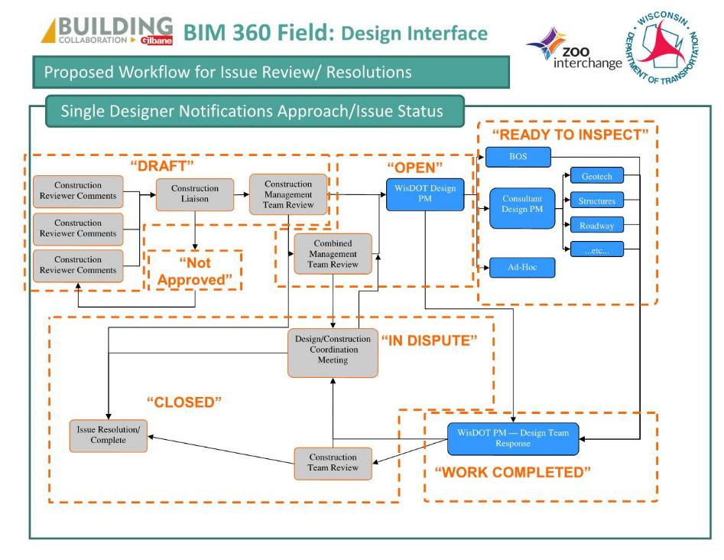
Step 2: Communicate
Process Flow
Feedback Workflow
The PS&E process has existing workflow. Where does C-rev fit-in?
^{Leverage C-Rev Platform}
^{“Out-of-the-box” functions}
Single Plan set Accessibility
Ball-in-Court / Assignments
Status: Draft, Open, Not Approved, Approved
Construction Comment Coordinator
Facilitate the process
Loading of plan set
Communicates email & notifications to team
IDENTIFY
COMMUNICATE
1
2
INCORPORATE
RESOLVE
4
3

Slide 30
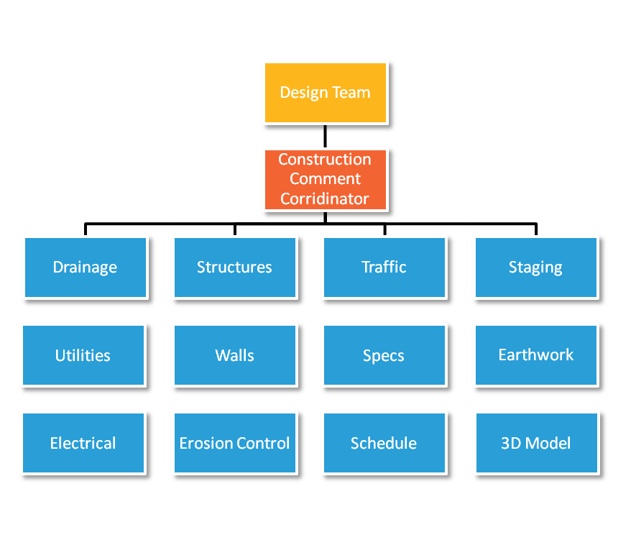
Step 2: Communicate
Team Onboarding
Consultant Structures
Consultant
Geotech
Consultant Roadway
Consultant Traffic Mgmt
Team Structure
Bureau of Structures
Consultant
Design PM
In-house Design PM
Ad-Hocs
^{Collaborative Team Makeup}
Designers
Construction Reviewers
Outside Parties – Local Municipalities, Private Utilities
Contractors
In-house reviewers onboarding process & training program
30 day roll-out
IT Trouble Shooting
System Admin / User Account Accessibility
Design Liaison

Slide 31
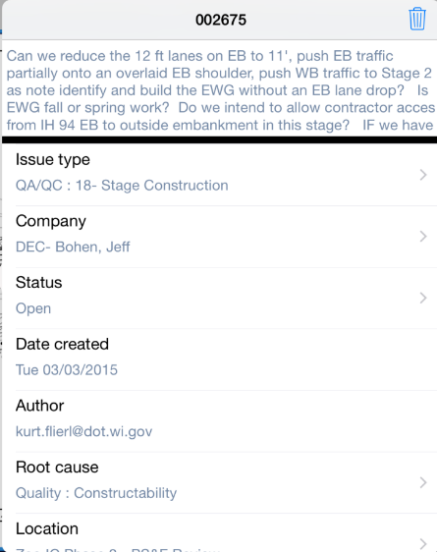
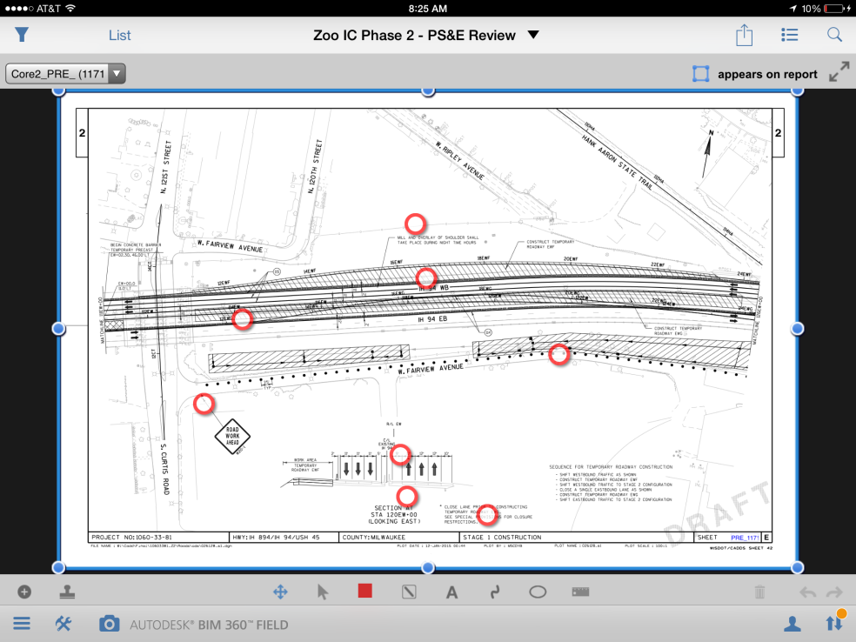
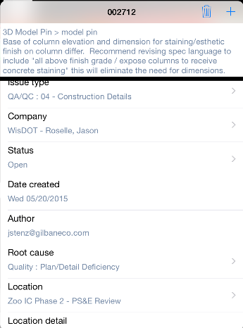
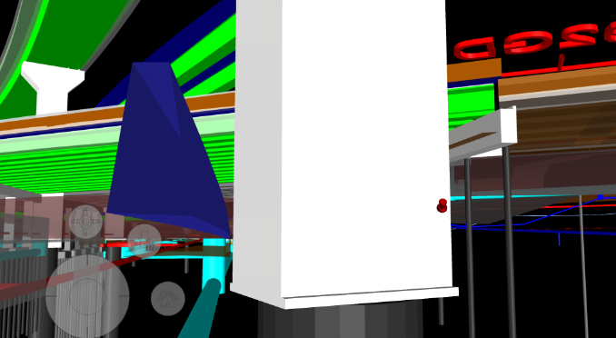
Step 2: Communicate
Process Flow
Effective Communicating
^{2D Plan sheets (online)}
ePlan comment “pinning”
Unlimited concurrent reviewers seeing real-time comments
Who, what, where, why, when
^{3D BIM models (infancy)}
Navigating in the model provided higher illustration of complex interfaces
3D comment “pinning”
“A picture is worth 1,000 words.”

Slide 32
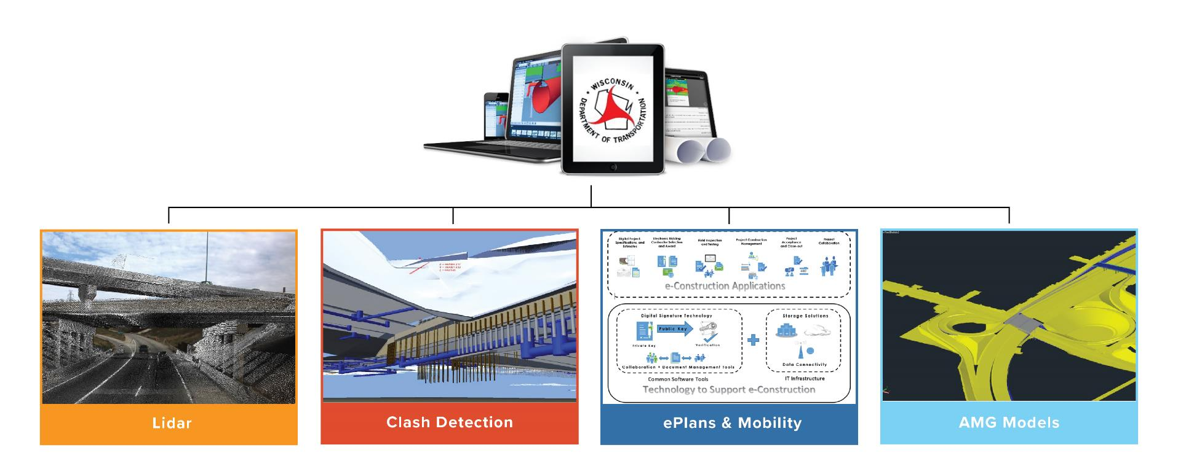
Step 2: Communicate
Building Information Modeling (BIM)
Why use BIM?

Slide 33
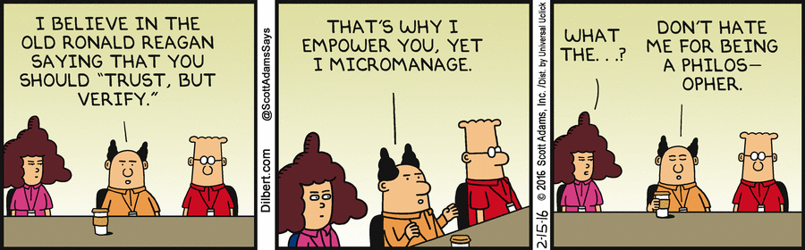
PS&E C-Rev
Step 3: Resolve

Slide 34
Step 3: Resolve
“Making Time”
30 Days
30 Days
30 Days
30 Days
30 Days
30 Days
30 Days
3D Model Review
GLUE360
Impacting the
Traditional Process
60% Plan Delivery Date
60% Review Meeting
Draft PS&E Delivery Date
Draft PS&E Meeting
^{Standard Projects}
^{Mega-Projects}
60% Model Snapshot Review; Plans released to industry for comment
60% Review Comment Resolution
Contractor Industry
60% Review Meeting
Draft PS&E
Model Snapshot Review
Internal Review
Draft PS&E Resolution Meeting
PS&E C-Rev
BIM360
= Traditional Process
= Feedback Process

Slide 35
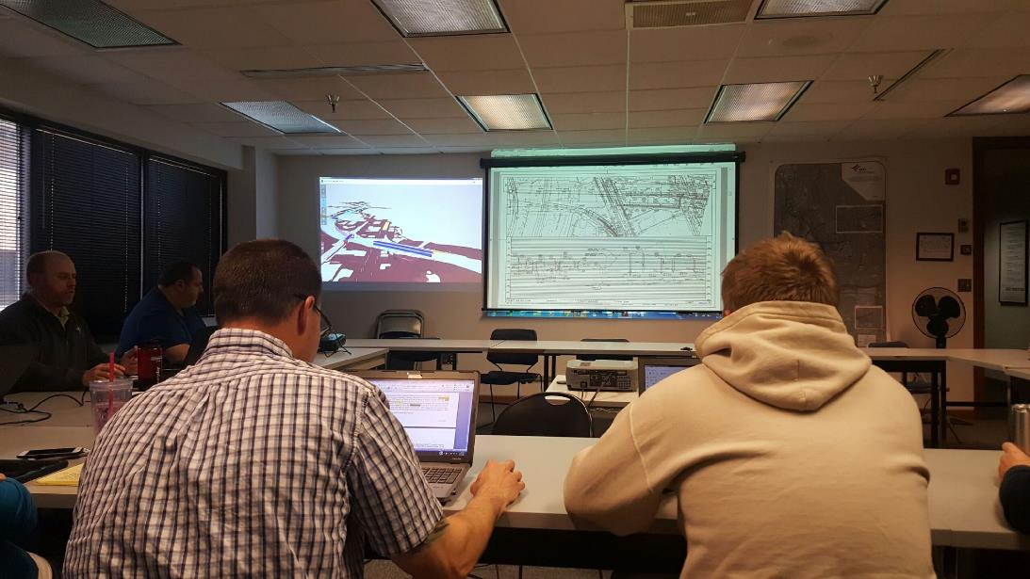
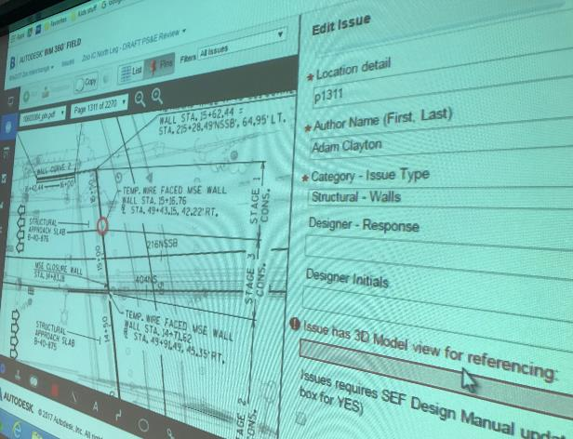

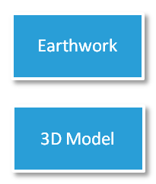

Step 3: Resolve
Dynamic Discussion
“Drive to Resolution”
Dedicated time / open door sessions
Specific to functional topics
Subject matter experts
  Design
  Construction
Leverage the technology to better enhance the conversation
  2D & 3D displays side by side

Slide 36
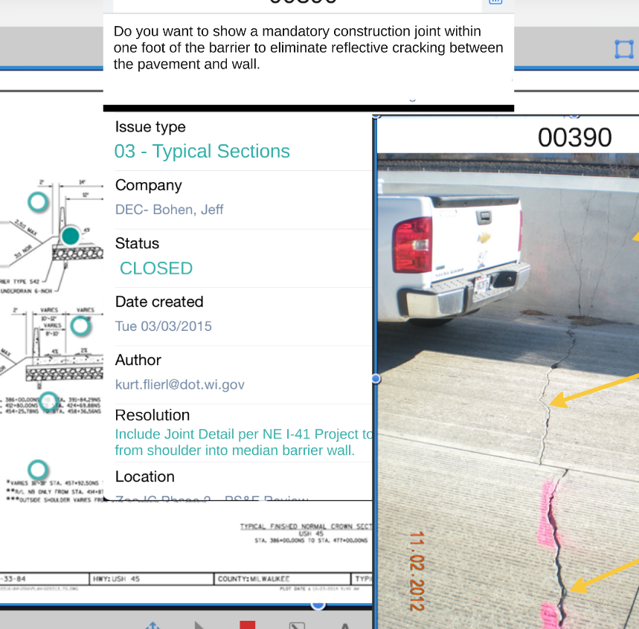
Step 3: Resolve
“Making Time”
Document Resolution
Formally address response:
^{Who responded (authority?)}
^{What was the decision}
^{Where was this decision made}
^{Why was the decision made}
When will the change be included?

Slide 37
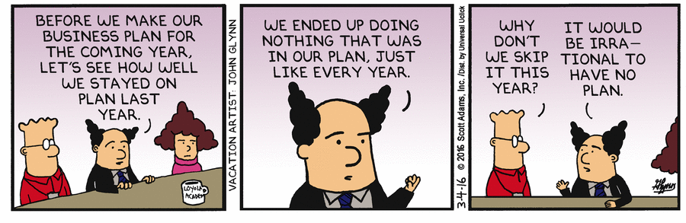
PS&E C-Rev
Step 4: Incorporate

Slide 38
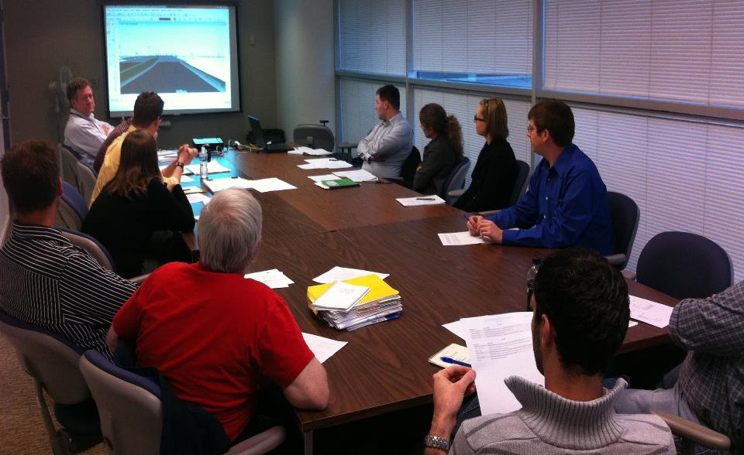
Step 4: Incorporate
Accountability
Ex. Utilities
Comment Integration
Meetings
Project Manager
Signals
FTMS
Roadway
Drainage
Structures
Design Team meets with functional design leads.
Comments are reviewed in meeting to coordinate amongst designers.
Each design lead is accountable for incorporation
Signing
Staging
Lighting
Pr. Utilities

Slide 39
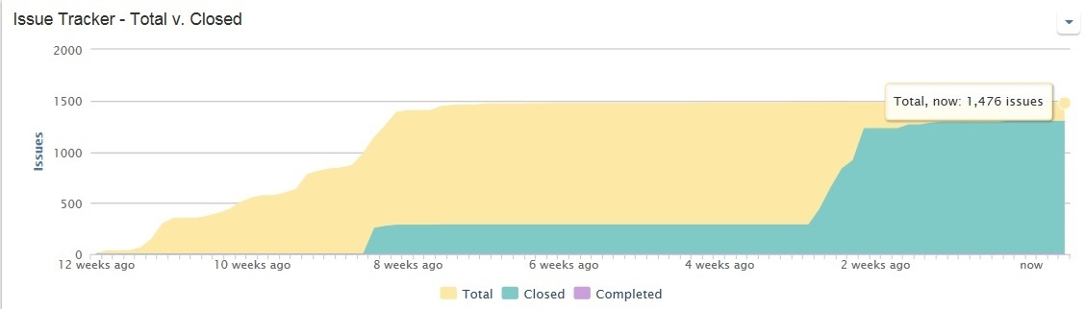
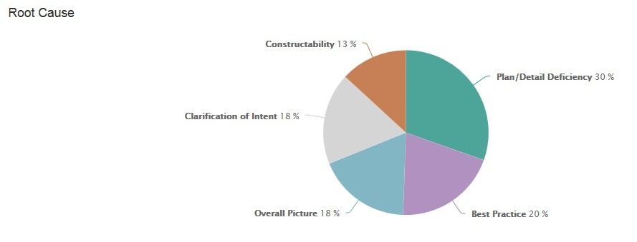
Step 4: Incorporate
Analyze the Process - ROI
Follow-thru Metrics
Gain perspective of your process
Construction Team Review
Design Team Review
Resolution
^{Measure your Design Weaknesses}
Improve your focal areas or QA/QC
Modify your plan delivery for future deliverables
REAL TIME
DASHBOARDS

Slide 40
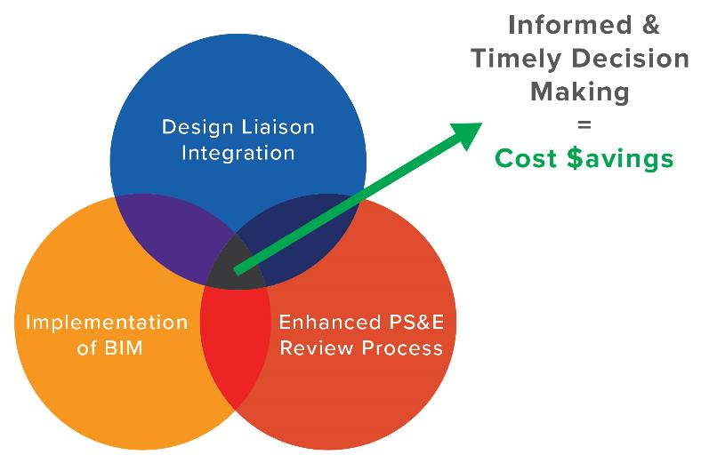
Results
Current ROI
IMPROVED – Zoo Interchange
PS&E C-Rev Process
  bid-ability
  constructability
  overall plan quality
$57.8M LET savings
$28.2M C.O. reduction
Change Orders % Contract Totals
Marquette Interchange
I-94NS / Mitchell Int
Zoo Interchange
7.09%
7.20%
3.43%
Notes:
Marquette
Original Contract Total Sum: $502,766,237.94
Revised Contract Total Sum: $538,403,700.43
C.O.’s issued $35.7M
Zoo Interchange
Original Contract Total Sum: $806,851,105
Revised Contract Total Sum: $834,552,195
C.O.’s issued $28.3 M
I-94NS
Original Contract Total Sum: $304
Revised Contract Total Sum: $326
C.O.’s issued $21 M

Slide 41
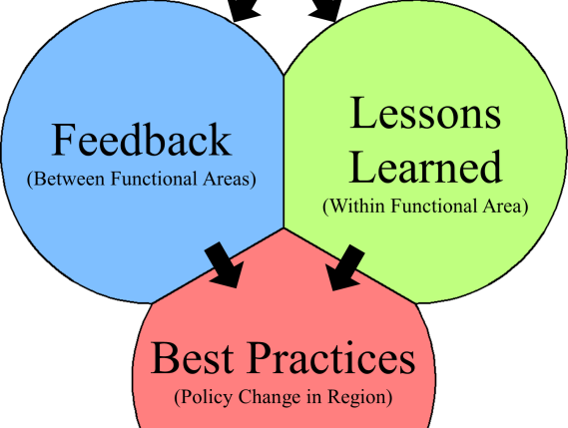

Results
Future ROI
PS&E C-Rev: Data Warehouse
Leverage the PS&E C-Rev
Review Comments
Promote higher quality deliverables by using between your teams
Feedback to Design
Best Practices
^{The more use, the higher ROI}
Mega Design Best Practices
Statewide Facilities Design Manual Changes

Slide 42
PS&E C-Rev
Road Map
Step 2
Step 3
COMMUNICATE
RESOLVE
Conflict
Commitment
Accountability
Step 1
Step 4
Cost
Schedule
Quality
IDENTIFY
INCORPORATE
Trust
Results
z
IMPROVED
  bid-ability
  constructability
  overall plan quality

Slide 43

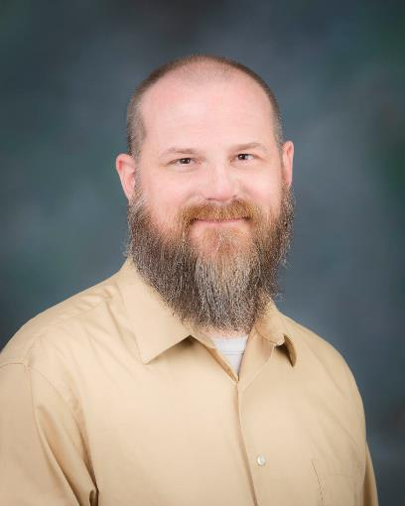
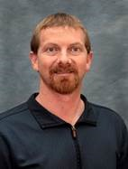
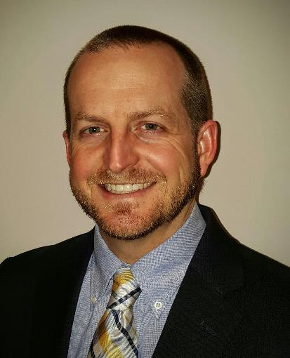

Your Panelists
Ryan Luck, P.E.
John Wilkerson, P.E.
Beau Hansen
Jason Roselle, P.E.
Notes:
0

Slide 44
Please enter your email address in the question box now to receive a form.
Self-Reporting Form

Slide 45

Leveraging PS&E C-Rev to Reduce Risk on Alt Delivery Projects
Wed, Feb 13, 2019 1:00 pm EST
Next Webinar

Slide 46


